Slide 1

Pairs Trading Algorithm for Financial Markets
ABHISHEK YADAV
22113007
CIVIL ENGINEERING

Slide 2
BRIEF SUMMARY
Pairs trading is a strategy that involves the simultaneous buying and selling of two correlated assets to exploit temporary divergences in their prices.
Pair Selection: Identify a pair of assets that historically exhibit a high degree of correlation. Common examples include stocks in the same sector, related commodities, or currency pairs.
Strategy- We will use RSI and Bollinger Bands Strategy :-
Buy Signal- When price touches or crosses below the lower Bollinger Band and RSI <30.
SELL Signals when price touches or crosses above the upper Bollinger Band and RSI>70.
RISK Management- Implement risk controls such as stop-loss orders or position sizing based on volatility measures ( eg. Average True Range) to manage risk and limit losses.
EXECUTION- Execute trades automatically based on predefined rules.

Slide 3
DATA EXTRACTION
With the help of yfinance python library I extracted all the data related to the stock by giving input as stock’s keyword and then fetch all the data from period 2014 – 2024.
data=yf.download('MSFT',period='10y',interval='1d’).

Slide 4
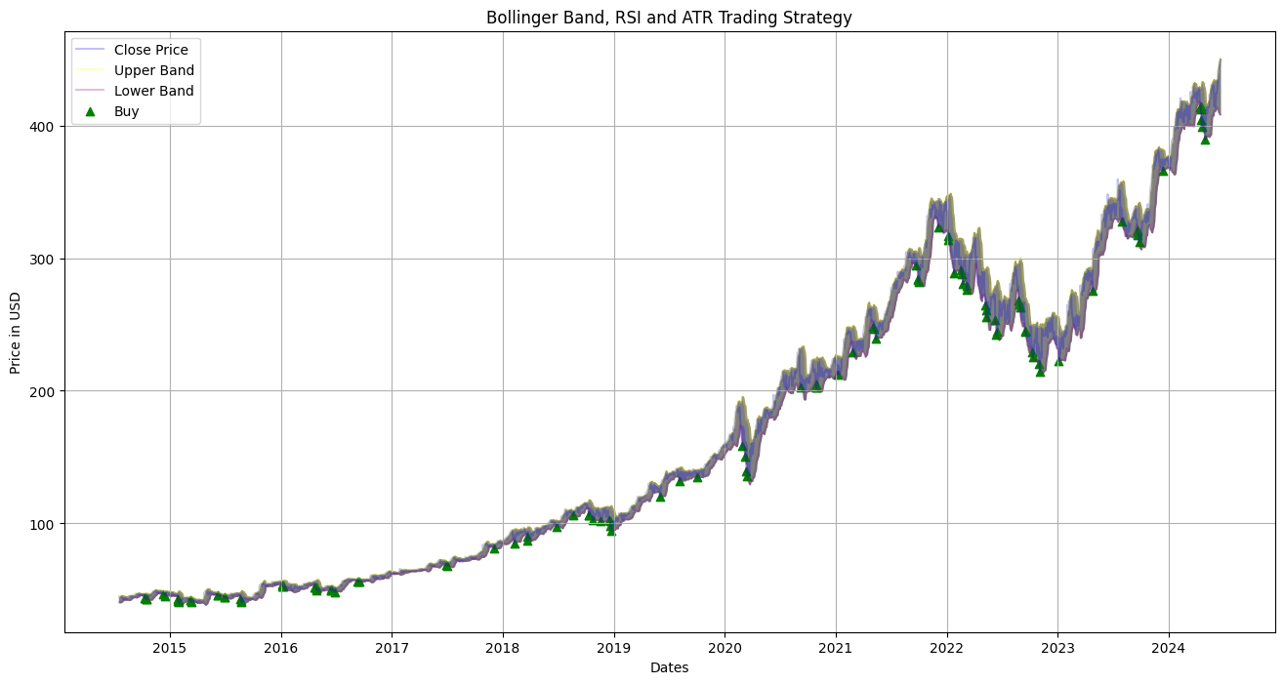
Plotting graph having buy and sell signal

Slide 5
Adding Stop loss and Take profit
Now we have signals for both call and put or buy and sell , Now our goal is to find stop loss and take profit region so that we can compute either the closing price will hit stop loss and book loss or hit take profit to book profit in the following days.
By using ATR , we were made stop loss and take profit for the signal.

Slide 6
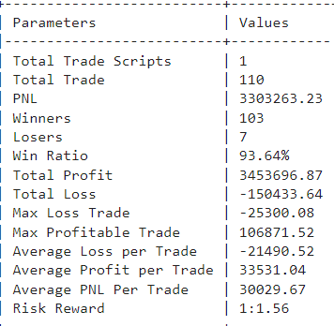
Final Step- Backtesting
Now its time to do backtesting , and check our signals accuracy weather they are capble of booking profit or not from news.
In Backtesting We compute following things like,
PNL, Sharpe Ratio, Max Drawdown, No. of winner Trades, no . Of losing Trades , etc

